Slide 1
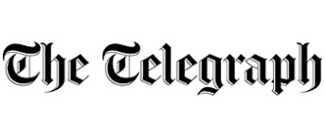


Twitter Data Comparison
& Sentiment Analysis
-Rutvik Gavaskar, April 2020

Slide 2
Introduction
The intention of this analysis is to study and compare the tweet trends of The Telegraph (@telegraph) and The Independent (@independent) during the corona virus pandemic.
This analysis is done based on 1100 recent tweets by these twitter handles.
Further 5000 tweets with mentions of each of these handles are extracted and analyzed to see the retweet pattern.
A combination of R and Python was used to download, process and analyze the tweets and other metadata.

Slide 3
About the handles
The Daily Telegraph, known online as The Telegraph, is a national British daily broadsheet newspaper published in London by Telegraph Media Group and distributed across the United Kingdom and internationally. It was founded by Arthur B. Sleigh in 1855 as Daily Telegraph & Courier.
The Independent is a British online publisher of news that was established in 1986 as a politically independent national morning printed newspaper published in London. Nicknamed the Indy, it began as a broadsheet and changed to tabloid format in 2003. The last printed edition was published on Saturday 26 March 2016, leaving only the online edition.

Slide 4
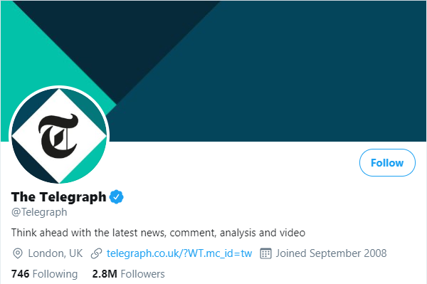
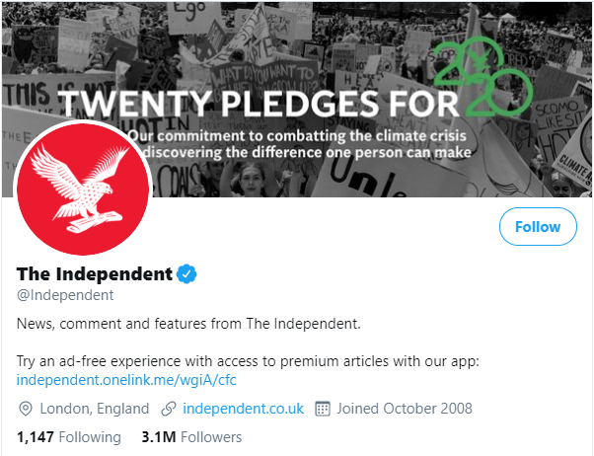
Twitter Profile Comparison
Both accounts are approximately 11.5 years old.
Surprisingly The Independent has tweeted almost thrice the number of times as The Telegraph.
This seems to be the reason of The Independent having more followers than The Telegraph.

Slide 5
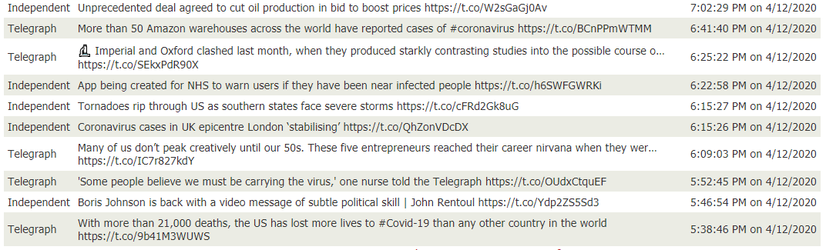
10 recent tweets from both handles

Slide 6
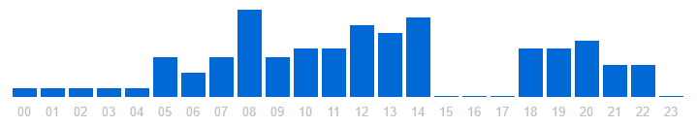
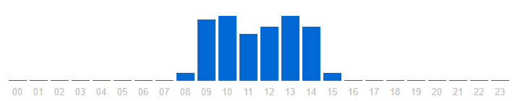
Active hours
It can be seen that “The Telegraph” has been active for more hours as compared to “The Independent”. Also it appears that the amount of tweets by “The Telegraph” are more than “The Independent” in a typical day.

Slide 7
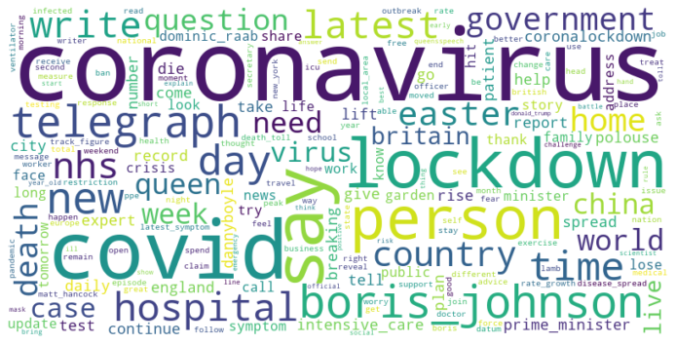
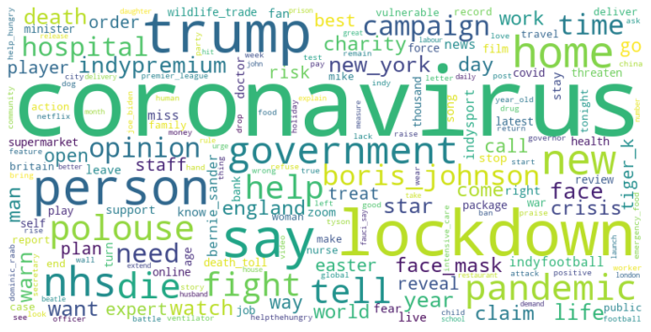
100 frequently words used in recent tweets.
‘coronavirus’ and ‘lockdown’ are prominently used words in the recent tweets. Surprisingly ‘The Independent’ has mentioned the U.S. president ‘trump’ a lot more than the British prime minister. While recent ‘The Telegraph’ tweets include mentions of British prime minister ‘johnson’.

Slide 8
Interactive Wordclouds (Click on the words to navigate)
Topics
Topics
ahead returning cough going rest covid19 short perfect 1000 countries record crisis peace home writer died coronavirus wins time fines problems discharged ignoring unite government issued said place nurse creative stories brooketaylor nhs easter medical needed tim journalists advice johnson despit china chief shields minister days prime fig testing lockdown stay boris writes delivery shouts pleas stars people health hospital watch
tiger dropped thunder lockdown opinion spoiler exotic eilish startling received easter kings boris news trolls needs response outbreak amid accuracy netflix huge moss billie sir british king pandemic johnson joe allegation taika thor nhs swimsuit hospital hits racing hate coronavirus makes dont reinke shows stirling says long photo world episode legend wave greatest nurses battle peter love trump people john chelsea
#Hashtags
#Hashtags
#easter #coronavirus #easterweekend #coronavirusupdate #protectthenhs #nhs #stayhome #stayhomesavelives #getwellsoonboris #coronavirusupdatebritain #lockdown #covid19 #virgingalactic #covid19pandemic
#coronavirus #cfc #banwildlifetrade #lebanons

Slide 9
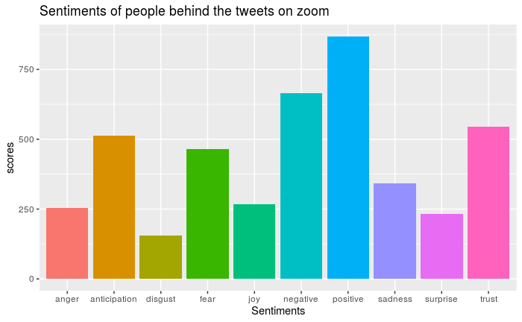
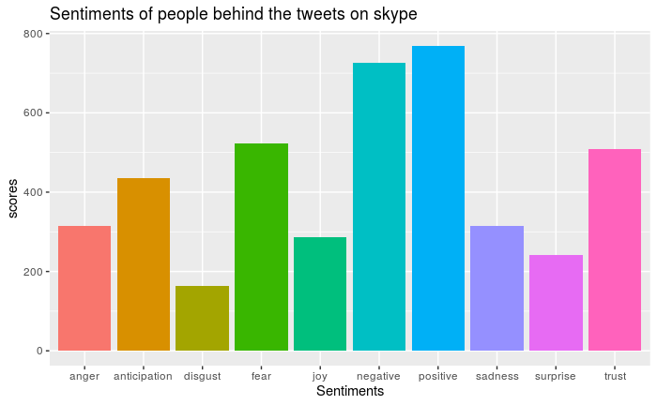
Sentiment score based on emotions
Both handles have similar usage of words in their tweets. ‘The Independent’ has used more negative words in their tweets as compared to ‘The Telegraph’.

Slide 10
Overall sentiment
These scores denote the overall sentiment of the recent 1100 tweets from both the handles. It can be seen that ‘The Telegraph’ has used more positive words than negative, while ‘ The Independent’ has equally made use of positive and negative words.

Slide 11
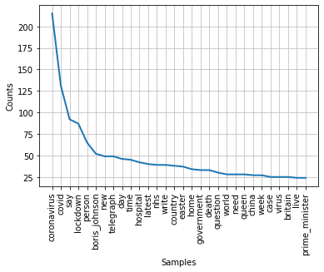
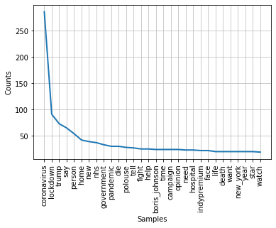
Word frequency

Slide 12
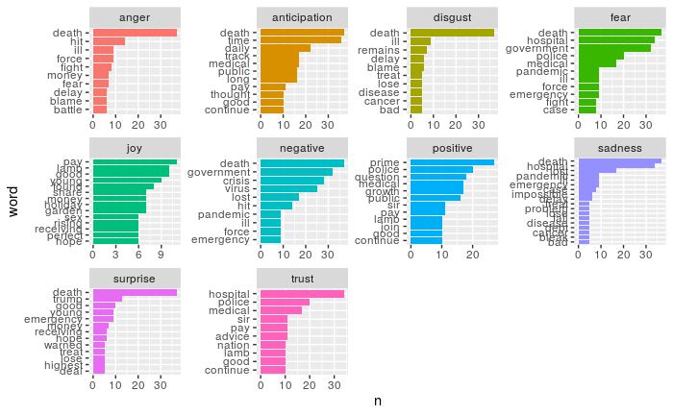
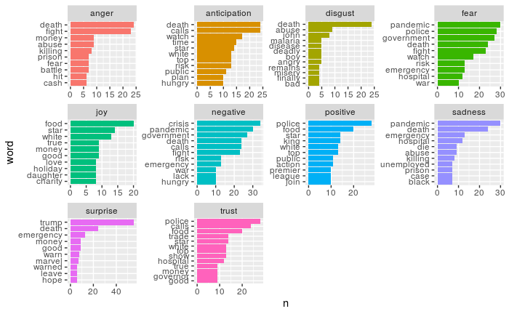
Usage of words
Here are the ways words have been used in context of an emotion. The x-axis has the word frequency while the y- axis displays the word. Similar trends can be seen in the word usage. ‘The Independent’ uses more words related to in context of ‘trust’, ‘anticipation’ and ’fear’.

Slide 13
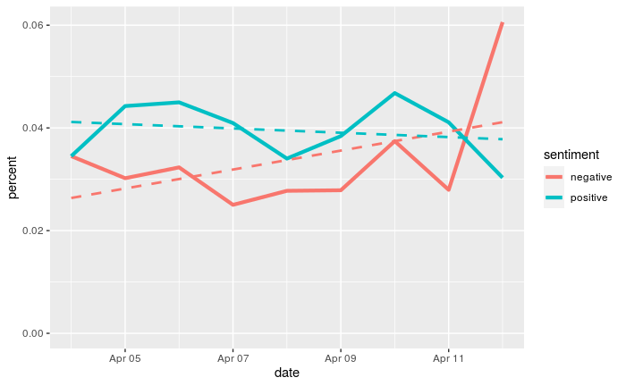
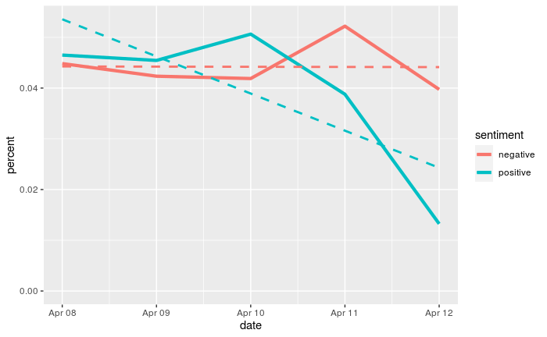
Tweet Sentiment in the past week
Between April 5th and April 10th , more positive words were being used, while on April 11th , a sudden increase of negative words was seen by ‘The Telegraph’. For ‘The Independent’, the usage of both positive and negative words went down, however more negative word were used in the tweets on April 11th .

Slide 14
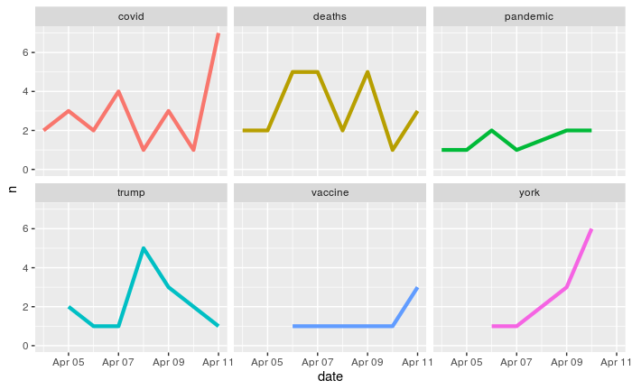
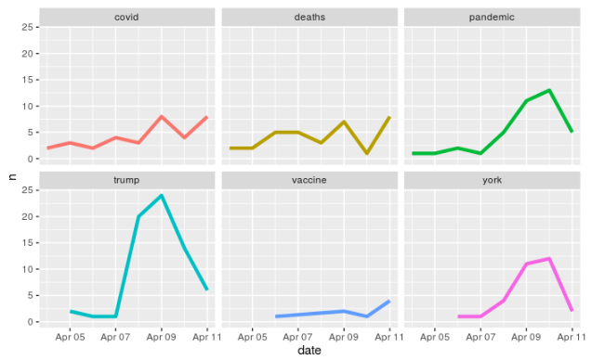
Word Usage Trend in the past week
These graphs show the usage of some common words in the tweets during the week of April 5th .

Slide 15


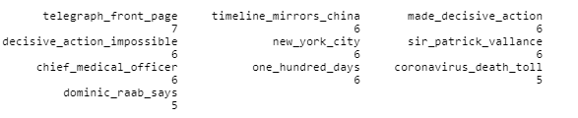
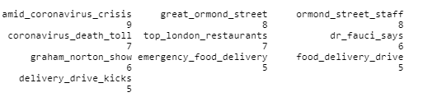
Bigrams and Trigrams
With these bigrams and trigrams, some common topics that were tweeted by these handles can be found. For example, it is evident that ‘The Telegraph’, had tweeted at least 47 times about British prime minister Boris Johnson in their recent 1100 tweets.

Slide 16
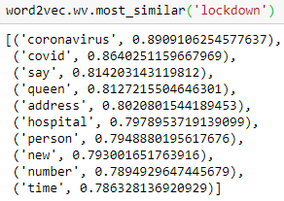
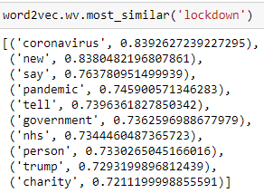
Similar words
Most of the tweets that consisted of the word lockdown also had worlds like coronavirus, queen and hospital among others.
Most of the tweets that consisted of the word lockdown also had worlds like coronavirus, trump and government.

Slide 17
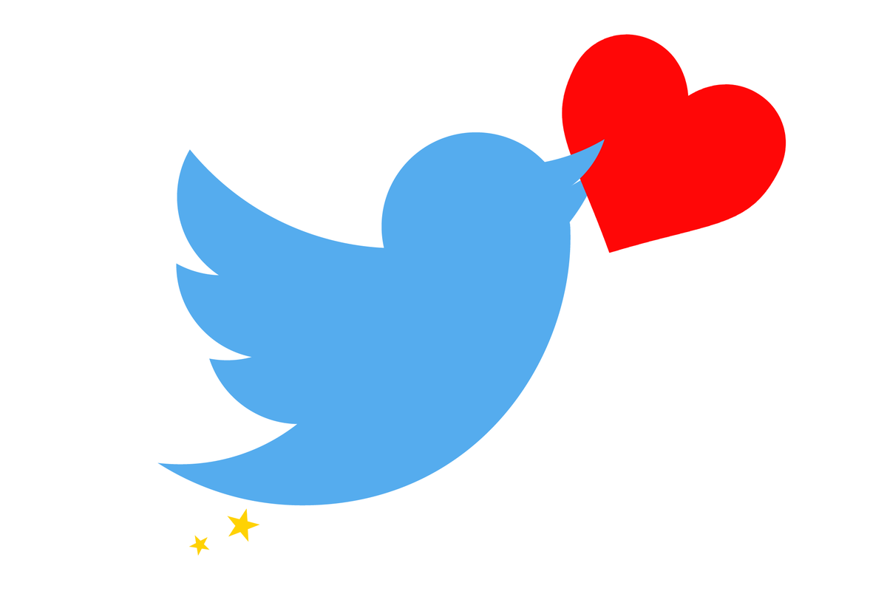
Favorites
80% tweets have either not been favorited or least favorited, while 20% tweets have been highly favorited.
Between 64% and 76% tweets have either not been favorited or least favorited, while between 24% and 36% tweets have been highly favorited.

Slide 18
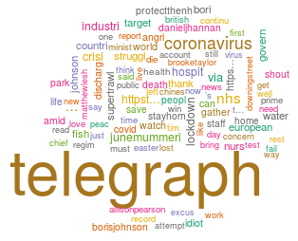
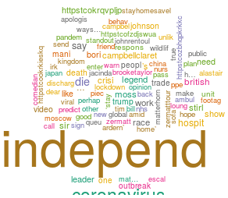
Let's look at the recent mentions

Slide 19
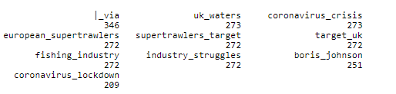

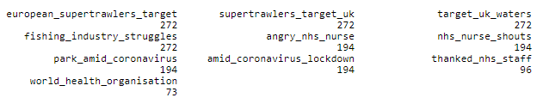
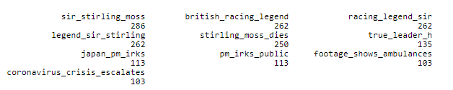
Retweets by topic
From these bigrams and trigrams, it can be found which tweets are being retweeted the most. For example, in the most recent 10000 tweets that mention these handles, ‘The Telegraph’s tweet that mentioned ‘fishing industry’ was retweeted 272 times, while ‘The Independent’s tweet that mentioned ‘sir stirling moss’ has been retweeted 286 times.

Slide 20
Devices used by followers
Almost equal number of followers of ‘The Telegraph’ have retweeted from iphone and android followed by ipad.
Android users have made more retweets as compared to iphone among the followers of ‘The Independent’ in the recent 5000 retweets.

Slide 21
End
It is the bleakest of ironies: the biggest news story in a lifetime is killing off the very industry that exists to report it. Coronavirus is destroying newsprint newspapers across Britain, delivering the coup de grace to businesses that were already in the process of dying.
Local and regional newspaper publishers have found it economically unsustainable to go on producing papers. In response, they have suspended the publication of scores of titles and placed hundreds of journalists on paid leave. “Furloughs” have become part of the new pandemic lexicon.
At national level, print runs have been drastically reduced because of distribution problems, most obviously resulting from the widespread closure of retail stores. Edition sizes have also been cut back due to the drop-off in advertisers. Similarly, many magazines are also forsaking print in favor of digital-only publication.
Hence, to generate revenue, these handles will have to tweet more and more with links in order to divert traffic to their online respective publications. This will also help in increasing the number of followers and subscriptions.

